Slide 1
Submitting a Budget Revision
Yosemite Community College District
Process Training

Slide 2
Budget Revision
A budget revision is done after the opening budget has been set up
It is done to increase/decrease the original amount of the budget
Or to adjust the original allocation of budget
A budget revision can be done multiple times in a fiscal year
Back-up is needed when submitting the budget revision
To provide the back-up you will use the CF Files
You can also include additional Pertinent Information
Example: Funder/Award Change Communication
Two ways to get to the file:
Yosemite.edu > Central Services > Administrative Services > Accounting > Accounting Forms in Teams
2. Or in the YCCD FS Round-Tables TEAM – Files in the CF Files Chancel
Right Click on Budget Revision and choose Open in App

Slide 3
Budget Revision
Enable the Content once the file is open
Choose the Fiscal Year you are working in
The information can be (but does not need to be) limited by:
Fund
Subfund
and/or Responsibility Code
Then you can either type in the account number or use the drop down to select an account number
Limiting the information when the file is open will reduce the number of accounts shown on the drop down list
When you see a red triangle in a cell you can hover over it for instructions on using that cell
Once you type in or select the account number you will see fiscal information about the account string

Slide 4
Budget Revision
Use the “Change” column to add or reduce the budget amount for that line item
Example: Object Code 54467 below is overspent
The budget will need to be increased for the object code
The total budget isn’t changing so budget in a separate object code will need to be reduced

Slide 5
Budget Revision
Budgets can be increased or decreased from multiple object codes
Make sure the total in the Change column is 0
Unless the total budget is being increased or decreased
The revised budget amount for an account should not be less then what has already been spent and encumbered from the account
Exceptions to this rule might be:
There is an expenditure transfer in progress that will be transferring expenses out of the account
A purchase order is going to be reduced
If this is the case you will enter the reason in the “Notes” Field on the form
If a salary object code is being increased or decreased:
Include the reason in the Notes field
Increase or decrease the corresponding benefits object code

Slide 6
Budget Revision
To add a new object code:
Type in the new object code in the New CF Num column on the left, after the last object code that is on the report
If a budget revision is going to be processed with an account that still has a negative balance, make sure to include the reason in the Notes field

Slide 7
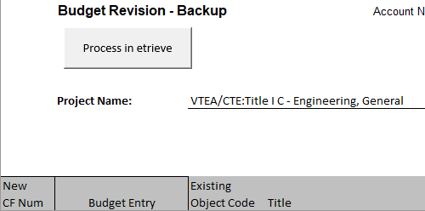
Budget Revision
Once the budget revision has been completed you can process the revision in Etrieve
To do so click on the Process in Etrieve button at the top
Doing so will save a PDF of the completed form on your desktop and open Etrieve
Log into Etrieve
Click on Forms
Click on ACTG Budget Revision
(under accounting)
You can also locate the form directly when you log into Etrieve Central

Slide 8
Budget Revision form in Etrieve
Enter:
The Fiscal Year
Your Phone Extension
The Grant or Contract Number – Or N/A if it is not applicable
The Funding Source
The Budget Manager
Choose the Location
Enter the Fund
Enter the Subfund
The description field should automatically populate, but if it doesn’t you can still proceed – but verify that you have entered the correct subfund
Enter the Responsibility Code and Activity Code
Enter or Select the Object Code
You will then see the current balance on the account

Slide 9
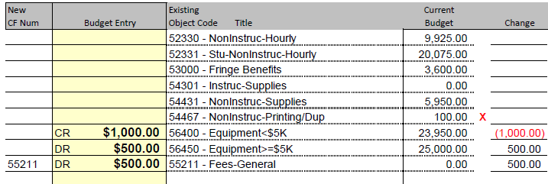
Budget Revision form in Etrieve
Enter the amount to increase or decrease the budget in the Amount field
Expenditures:
A Positive Number in the Amount field will increase the Budget for that account
A Negative Number will Decrease the Budget for that account
Revenue and Fund Balance:
A Positive Number in the Amount Field will DECREASE the Budget for that account
A Negative Number will INCREASE the Budget for that Account
A reminder is included on the form
The budget revision also shows if it should be a Debit (+) or a Credit (-)
Debits are entered as a Positive Number
Credits are Entered as a Negative Number
Press the Plus to add additional Account Numbers

Slide 10
Budget Revision form in Etrieve
Enter the Explanation of Budget Revision
18 Characters or Less
This is what will show up in the General Ledger, so it should help identify why the revision is being processed
Example: Award Increase
The system will automatically enter the location and “Adj” before the description that is typed
Example: 8346MJC Adj Award Increase
Enter the Comments
These comments will not be displayed in Colleague, but will be useful for those approving the budget revision, and if someone looks at the revision in the future they would know the reason for the budget revision
Attach the Backup
Click on Attachments at the bottom of the screen
Select Upload File(s)
Locate the Budget Revision file on your desktop
Etrieve only supports the following file formats:
.jpg .tif .xps
.pdf .jpeg .png
.tiff .bmp .gif

Slide 11
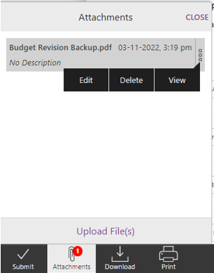
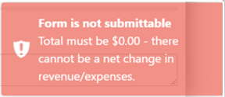
Budget Revision form in Etrieve
Additional backup is always required to:
Increase or decrease the overall budget
To revise the revenue amount
Click on Close when all files have been attached
Click on Submit when done
If the form is not in balance you will get an error
Make sure you have your Positives and Negatives correct
Error if you have an extra line – to remove it click on the - button

Slide 12
Budget Revision form in Etrieve
A red X identifies a new account number with no activity in the fiscal year
Recheck the account number to ensure it is correct
If the account number is correct it will be added to the General Ledger by Accounting Staff
If the form “Times Out” you will need to refresh your browser
You would then need to add any missing information and submit the form again
The form will not submit if any information is missing or if the balance is not 0
Once the form is submitted the form and the attachments can not be edited or deleted by the submitter.
If the form was referred back to the submitter then they would be able to edit the form or add additional attachments

Slide 13
Budget Revision form in Etrieve
At any point through the workflow the person receiving the form may either refer the form back to the sender
Or to anyone else for review prior to approving the form
If the form needs to be cancelled for any reason the next approver would need to decline it
This would result in the form ending without posting
To View the form you can go to Activity
If the form is ended prior to 3pm then the transaction will be posted in the General Ledger the next business day
If after 3pm it will be posted on the 2nd business day
Use History to see where the form is in the workflow process or to view any approver/viewer notes

Slide 14
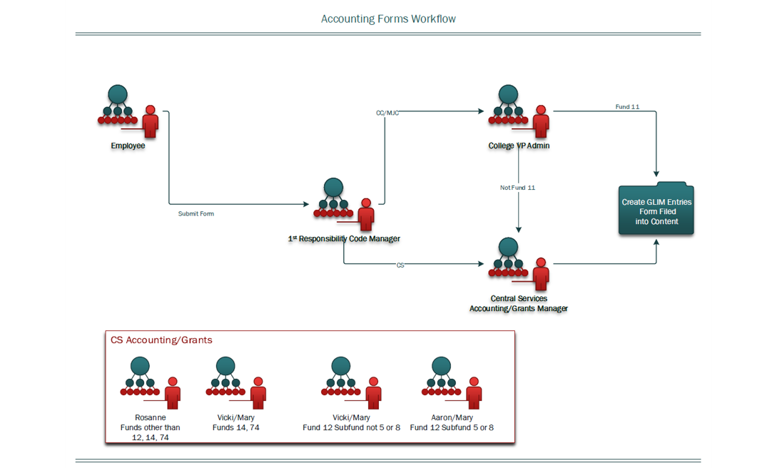
Budget Revision form in Etrieve
Workflow for Budget Revisions

Slide 15
Budget Revision
Links to additional information about working with Etrieve
Link to Etrieve Forms: https://etcentral.yosemite.edu/#/form
Link to Workflows: https://modesto.instructure.com/courses/20306/pages/Etrieve%20Workflows?titleize=0
Link to Etrieve Trainings: https://modesto.instructure.com/courses/20306/modules
Contact Central Services Accounting if you have any additional questions about the process.
Or if you have any issues arise throughout the process
Contact Information:
Vicki Fontana x6532
Mary Bylsma x6534

