Slide 1
Setting Up a Budget for a Restricted Account
Printable Information for:
Yosemite Community College District
Process Training

Slide 2
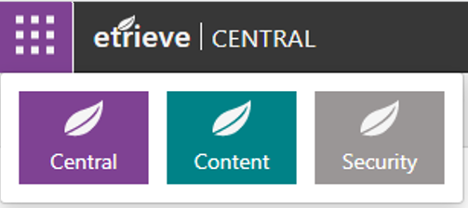
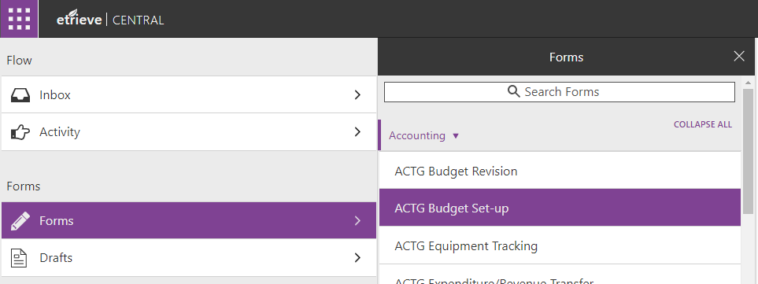
Budget Set-up
A Budget Set-up form is submitted in Etrieve
Either at the beginning of a new grant cycle
Or at the beginning of the fiscal year
The fiscal year is July 1 through June 30
Log into Etrieve
etcentral.yosemite.edu/
Forms
Accounting
ACTG Budget Set-up

Slide 3
Budget Set-up
Enter information in the following fields:
Fiscal Year
The drop down will list available fiscal years
If it is a new grant this would be the current fiscal year
Or it could be the next fiscal year if you are setting up the budget for next year
When multiple fiscal years are available make sure to choose the correct fiscal year
Your Phone Extension
The Program Name (Example: Strong Workforce Local FY 2021-22)
The Grant/Contract Number (If there is no Grant or Contract Number enter N/A)
The Performance Period (Time frame that the budget will be in place)
The Total Funding Amount
Type of Funding (Federal, State or Local)
Funding Agency
Fund (XX-0000-0000-000000-00000) (for restricted accounts the fund is 12)
Subfund (12-XXXX-0000-000000-00000)
The Budget Manager
Intended Restricted Purpose of Funding
The Location (MJC, CC or CS)
The Division

Slide 4
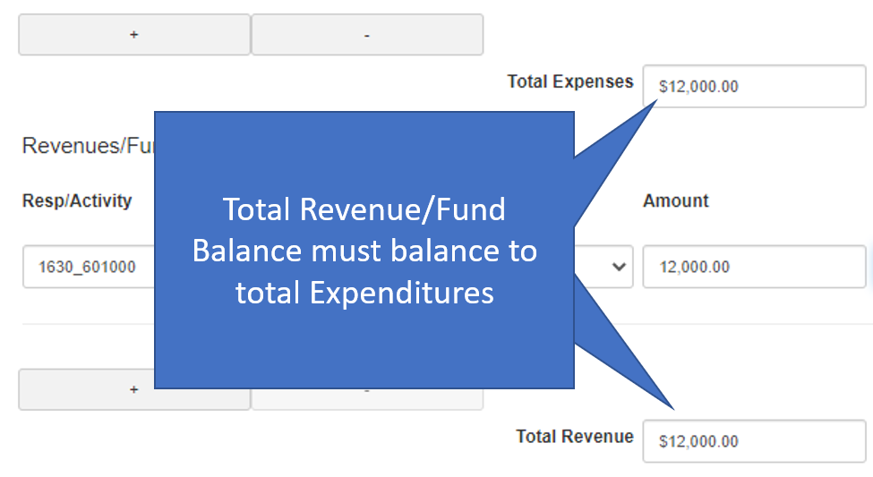
Budget Set-up
First Number in the Object Code:
3 – (3XXXX) - Fund Balance
4 – (4XXXX) – Revenue
5 – (5XXXX) – Expenditures
Enter the following information for both Expenditures and Revenue/Fund Balance:
Responsibility Code and Activity Code (00-0000-XXXX-XXXXXX-00000)
Object Code (00-0000-0000-000000-XXXXX)
Budget Amount for that Object Code
Use the + button to add additional accounts
A Red X means it is a new account number
Total Expenditures must match total Revenue/Fund Balance
A summary of information is available at the bottom
Attach the required Documentation
This should be backup verifying the award and amount of the budget
Include any comments that might be useful in the future
Click on Submit when done

Slide 5
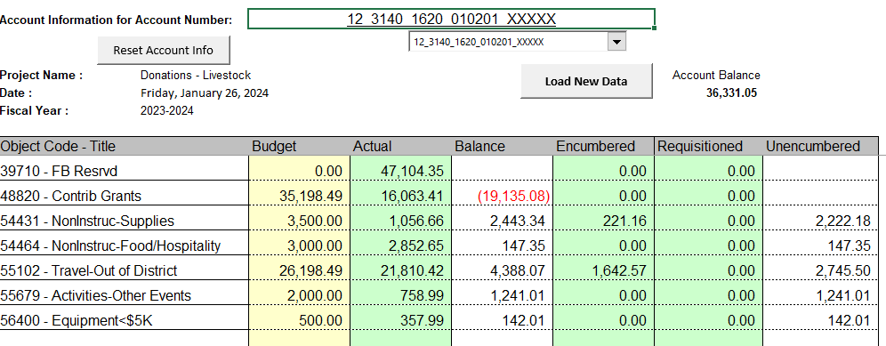
Budget Set-up
Appropriate Backup
Executed Contract Memo from Grants showing the granting agency and the total award amount
A copy of the signed and fully executed contract from the Granting Agency
Prior Year Account Information to Justify the new year Budget
Example: Account Information Report
This budget started off the year with a fund balance of $47,104.35
Has received $16,063.41
Has spent $26,836.71
So the new year budget would start off with a fund balance of $36,331.05.
Any additional Revenue would be added to that amount to get the maximum expenditure budget amount
Revenue vs. Fund Balance
Revenue (Object Codes 48XXX)
New Anticipated Revenue
Funds that were received in a previous year but not earned (carryover)
Fund Balance
Prior year revenue earned but not spent (Object Codes 397XX)
State and Federal Grants should not have a fund balance account

