Slide 1
Yosemite Community College District
Process Training
Requisition Input and Tracking

Slide 2
Requisition: Input and Tracking
Requisition procedure
Etrieve Content overview
How to attach supporting documentation
How to track a requisition through the entire PO process
Colleague Screens:
REQM – Requisition Maintenance
RINQ – Requisition Inquiry
PINQ – Purchase Order Inquiry
BINQ – Blanket PO Inquiry
RREG – Requisition Register

Slide 3
Accessing Requisition Screens
Requisition: Input and Tracking
The REQM – Requisition Maintenance Screen is used to:
Enter a New Requisition
Review an Existing Requisition
Make Changes to an Existing Unfinished Requisition
Finish an Incomplete Requisition
Entering a new requisition
Determine if it is a New Vendor
Get your Quote
Enter the Requisition

Slide 4
Requisition: Input
1. Determine if it is a new Vendor
Use the VEIN (Vendor Inquiry) screen to lookup your vendor by Name
Record not found means it is a New Vendor
2. Get your Quote
Obtain a quote from the vendor
Print out the quote as back-up – or save as a PDF
This is required
All quotes must be current
Verify that the quote has the following Information:
Ship to Either:
Bill to:
Terms:
2201 Blue Gum Ave Modesto CA 95358
11600 Columbia College Dr Sonora CA 95370
Yosemite Community College District
PO Box 4065
Modesto CA 95352
Net 30 Terms
3. Enter the Requisition
The REQM – Requisition Maintenance screen is used to enter a new requisition
Enter A to Add
Allow Colleague to Assign the number Automatically
REQM is also used to modify an existing requisition

Slide 5
New Vendors
Requisition: Input
It is up to the Department to:
Contact the vendor for a W9.
Verify that they accept Purchase Orders.
Request an E-mail address and/or a fax number so the PO can be sent.
Verify that the vendor accepts Net 30 Terms
Verify that the vendor accepts payment by check
Once you have received the W9, please E-mail it to Purchasing.
Purchasing will create the vendor in Colleague and provide you with their Vendor ID #
Once you receive the vendor number go back into REQM and add the vendor number.
A requisition cannot be added without a Vendor ID.

Slide 6
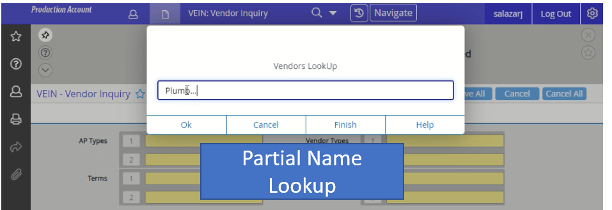
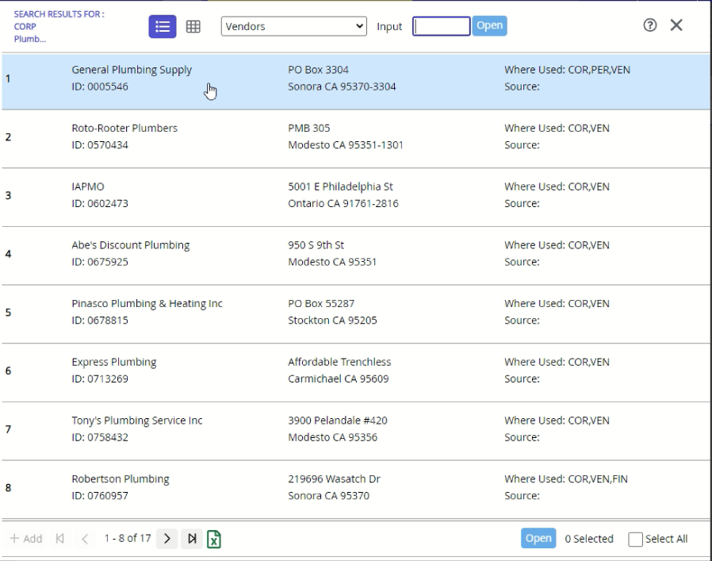
Requisition: Input
Use the … wild card to get a list of vendors that meet a specific criteria.
Example: Plumb… will provide a list of all vendors with Plumb in the name
Page 1 thur 8 of 17
Once you choose a vendor from the list, make sure to verify that the vendor you meant to choose by verifying the address
Use Arrows to see additional names on the list
The list can also be exported to Excel

Slide 7
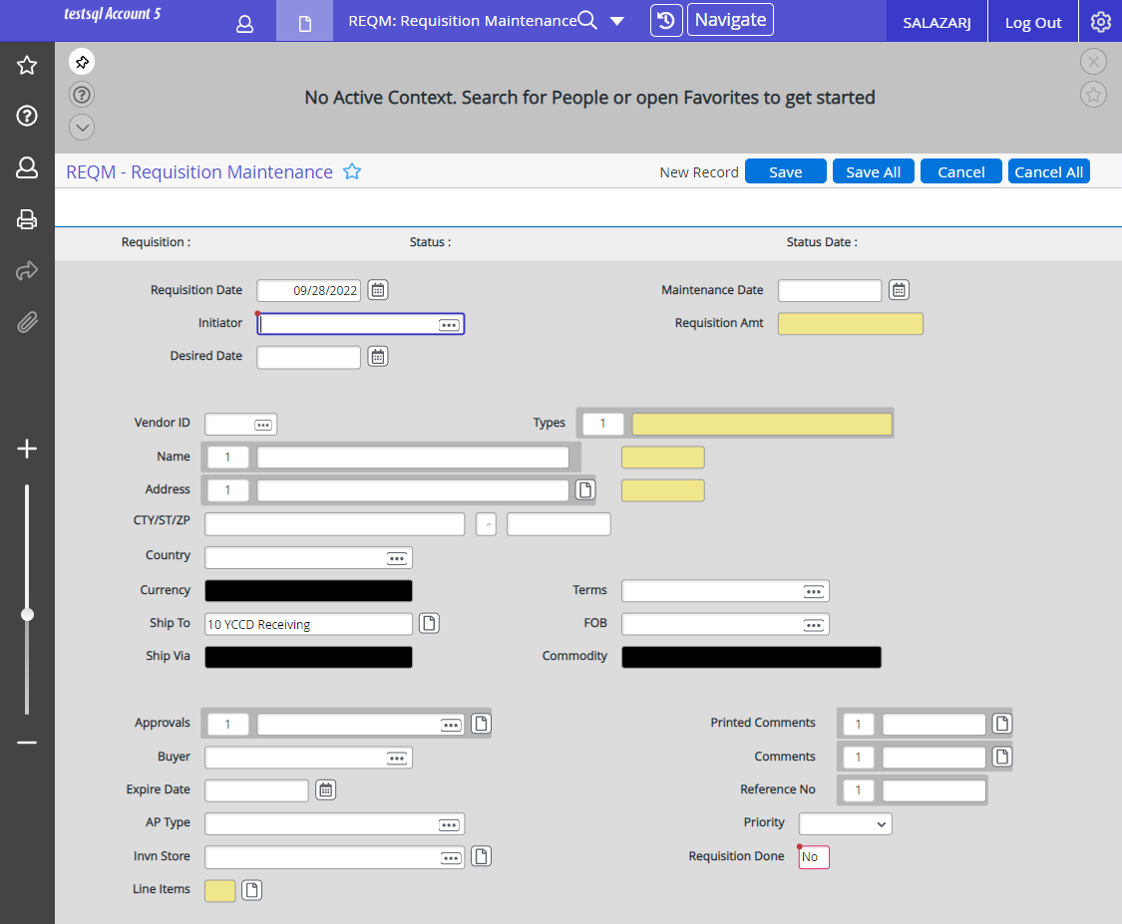
Enter your
Colleague Employee ID #
Desired Date
Vendor Number
Choose the correct addresses
Add your Approvers
AP type (usually this is AP)
Line item Details
Comments
Enter YES when Done

Slide 8
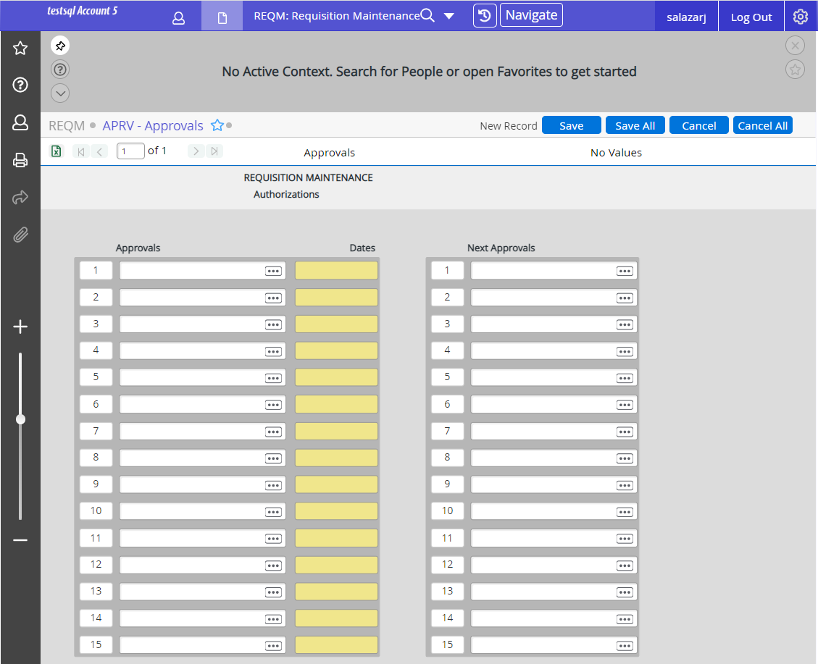
Approvals
Tip:
If you aren’t sure how to spell the name you can use the … wild card to get a list of names
Example:
sa… will bring up a list of everyone with a last name that starts with Sa
Enter first approver
Ex: Johnsondo
(First part of their
e-mail address)
Normally you only enter ONE name under Next Approvals
Once that person approves the requisition they will enter the name of the person that needs to approve the requisition after they do

Slide 9
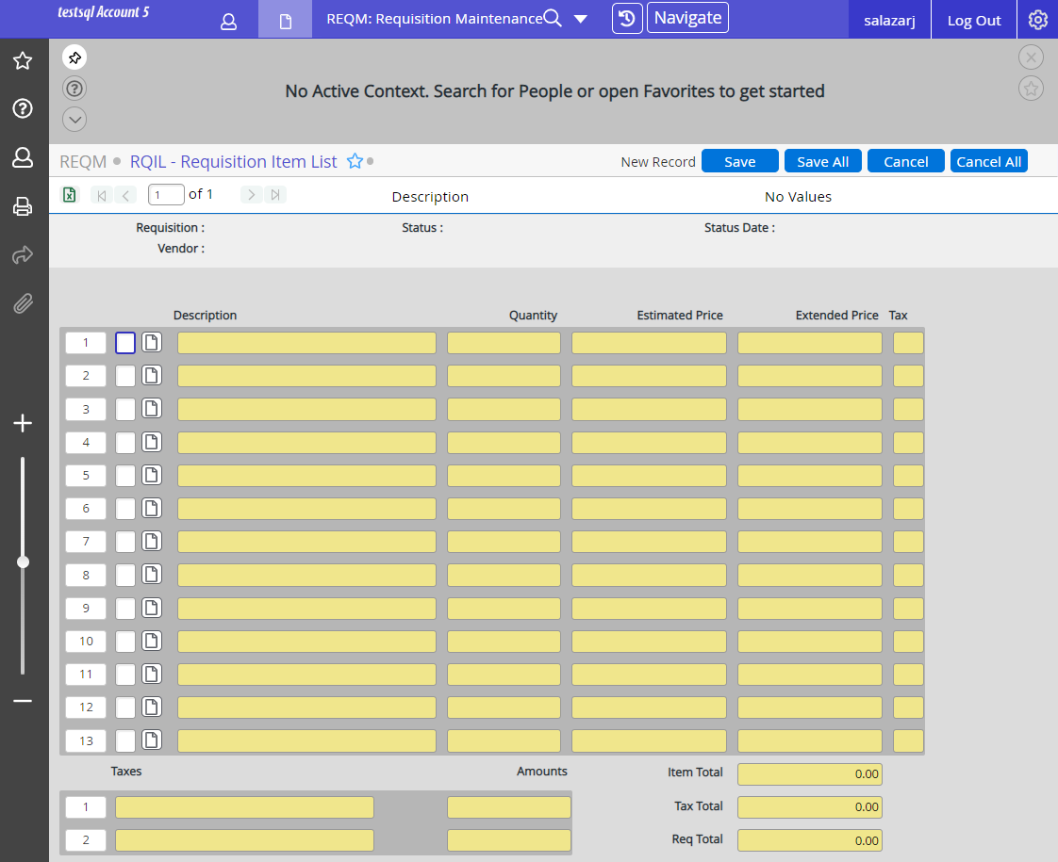
Requisition: Input
RQIL – Requisition Item List
Drill into description to enter Line Items
At least one line item must be entered in order to save the requisition

Slide 10
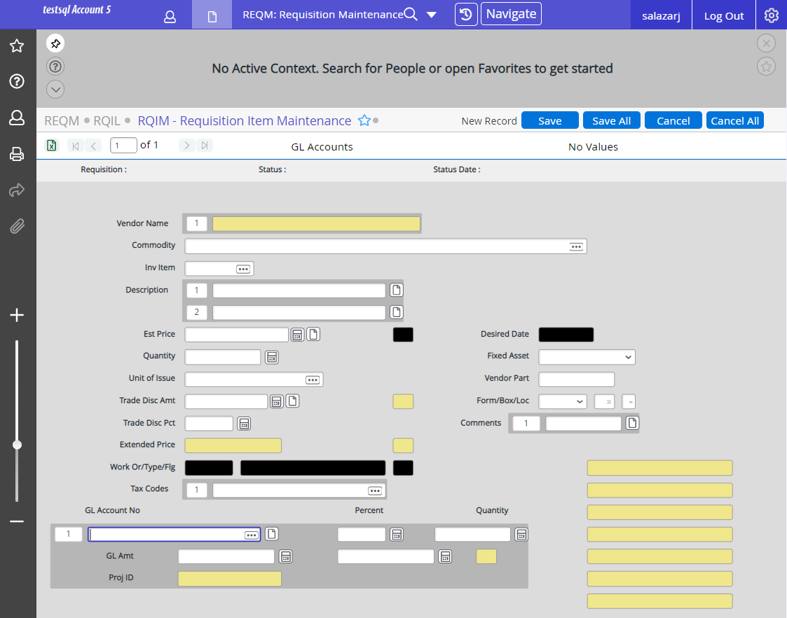
Requisition: Input
RQIM – Requisition Item Maintenance
Drill in to add a the description of what is being purchased

Slide 11
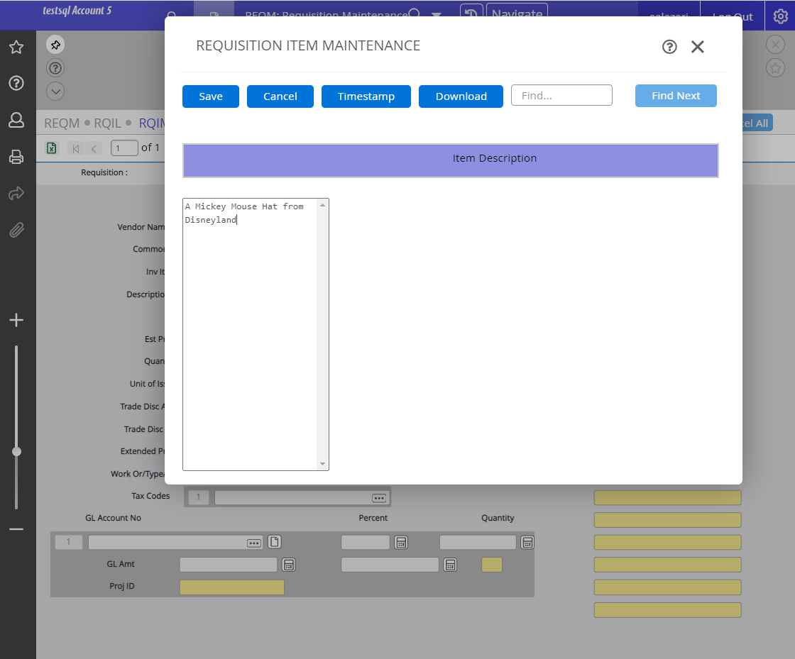
Requisition: Input
Enter Detailed Description Include;
Item Description
Part or SKU number
Include the description that is on the quote
Enter a description of what is being purchased
Include the description that is on the quote
Save out once the description has been entered

Slide 12
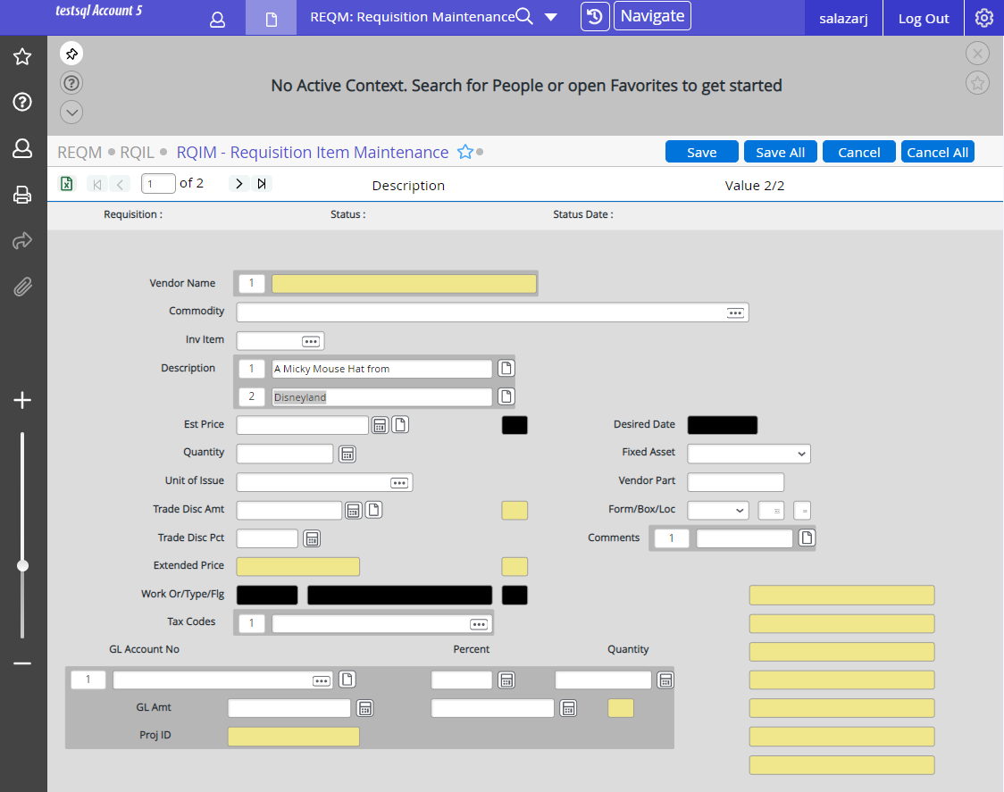
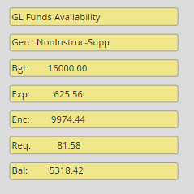
Requisition: Input
Enter The Price
Quantity
Unit of Issue
Tax Code
SS-Stanislaus County
ST- Tuolumne County
Make sure there is enough balance in the account to cover the cost
Do not enter a tax code when the requisition is for a service
GL ACCOUNT No.
Enter one of these
The Amount to Charge to the account number
Percentage to Charge to the Account Number
Or the quantity to charge to the account number

Slide 13
Requisition: Input
Save or F9
Then Cancel

Slide 14
REQM – Requisition Item Maintenance
Shipping Charge
If there is a charge for shipping you will need to include it as a separate line item
The description will be:
Shipping Charge
Include the dollar amount
If the quote includes a fee for “Shipping and Handling”
Include Sales Tax
If the additional fee is only for “Shipping” or “Freight”
Don’t Include Sales Tax
Basically – Shipping is not taxable, but Shipping and Handling is

Slide 15
Add your notes to Purchasing in the Comments
An example of notes to Purchasing would be the previous PO Number
Drill into comments field
Purchasing use only (printed comments)
Enter YES when Done

Slide 16
Requisition: Input
Comments Field
Use the Comments Field for the following information:
Delivery Point
Department Name
Building and Room Number
Initiator
Include Phone Number
Source of Price
Examples:
Vendor Website
Contact Name Flyer
Catalog Invoice Number
Previous PO Quote Number
Contract Number

Slide 17
Requisition: Input
Comments Field
Use the Comments Field for the following information:
Federal Grants
If the funds being used to purchase the item are from a federal grant make sure to include:
- Purchased with Federal Funds -
Subfunds beginning with an 8 are federal grants
12-8110-1620-010100-56400
Instructions to Fax Purchase Order to the Vendor
Include Fax Number
New Vendor
Include Phone and Fax Number
If there is additional information that needs to go with the Requisition make sure to include
BTF (stands for Back-up to Follow)

Slide 18
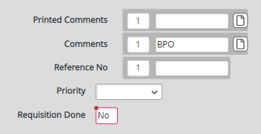
Create a Blanket Purchase Order
A BPO is used for vendors in situations where repeat orders to replenish supplies will be used throughout the year
Same Process as creating a regular Purchase Order
Except you will have to add BPO in the Comments Field when creating your requisition
A BPO can NEVER be used for EQUIPMENT

Slide 19
After completing the requisition a number will be assigned, click OK to continue
Requisition: Input
Make note of the requisition number
Back up to Follow (BTF) is provide through Etrieve
RREG – Requisition Register
The first step to using Etrieve to attach the back-up/quote is to use the RREG screen in Colleague

Slide 20
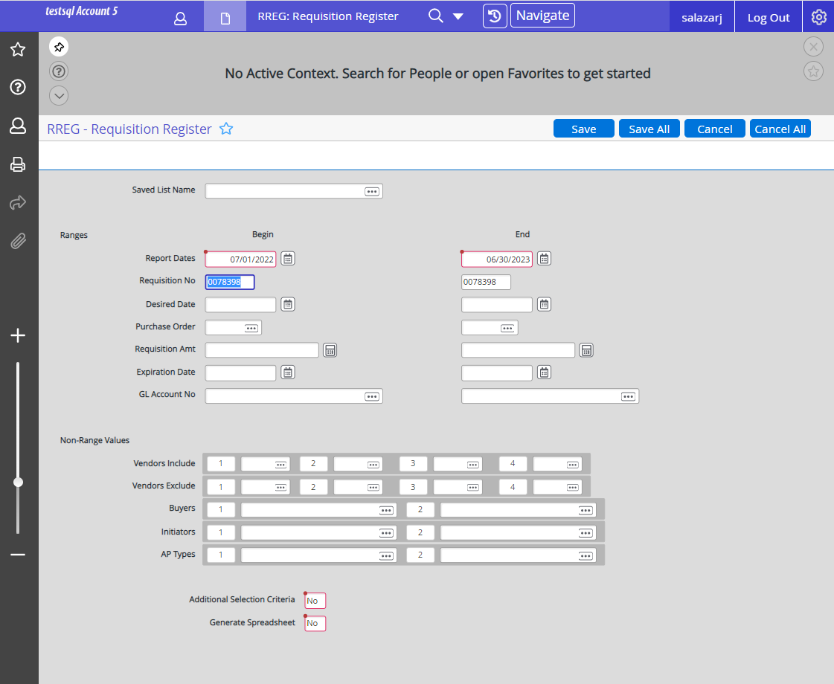
Accessing Requisition Screens
Report dates should be CURRENT fiscal year (Ex. 7/1/2022 TO 6/30/2023
Pre-populated – Needs to be Updated
Pre-populated – Needs to be Updated
Ctrl+Alt+D to Delete the Current Number
Then Enter a New REQ#
Ctrl+Alt+D to Delete the Current Number
Then Enter a New REQ#
Both Boxes MUST
Have the same Numbers

Slide 21
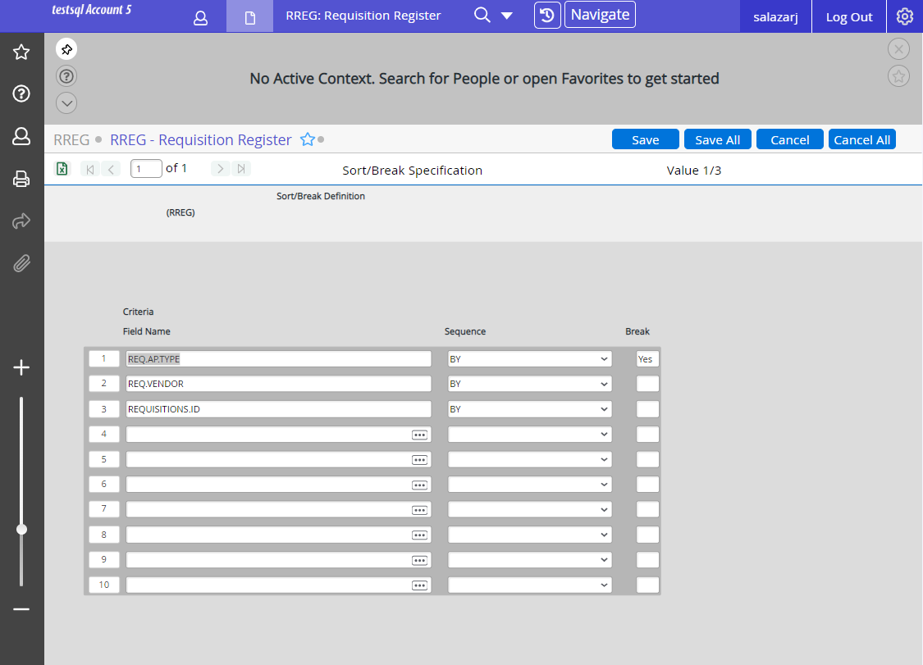
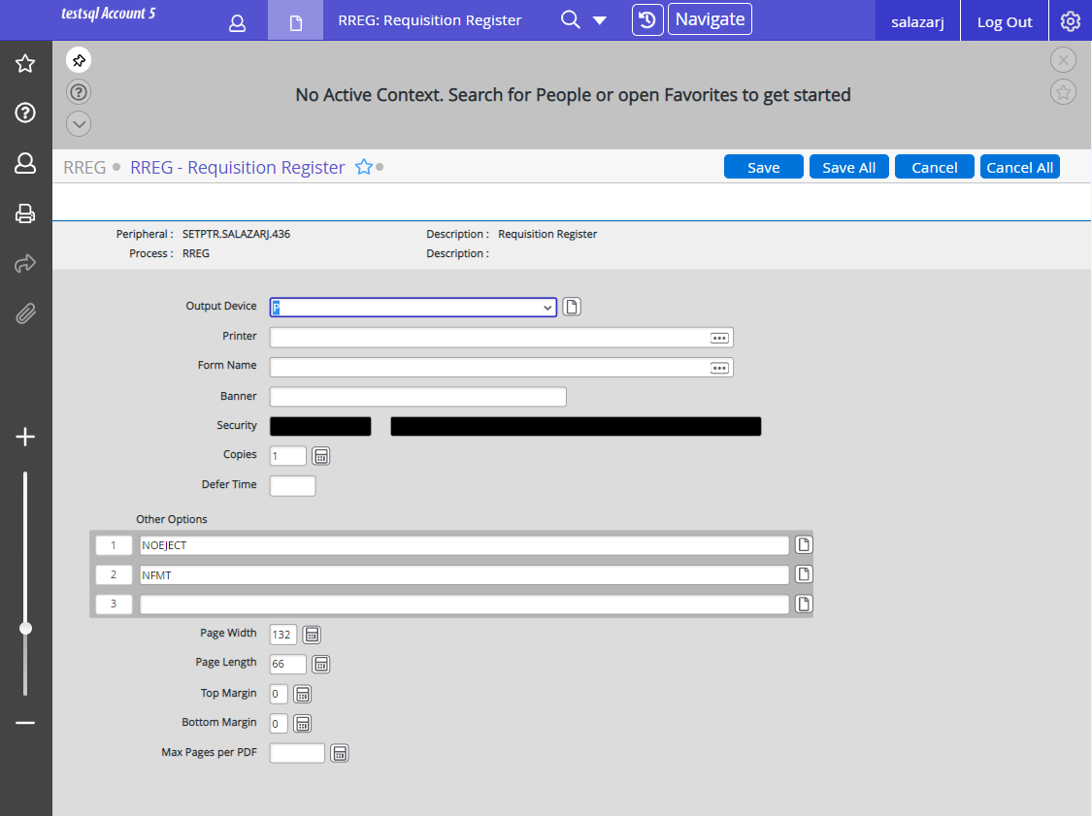
Accessing Requisition Screens
F9 then U(update) to continue on to next page
Enter name of printer ISAIGPTR1
Enter printer: ISAIGPTR1
Then Save

Slide 22
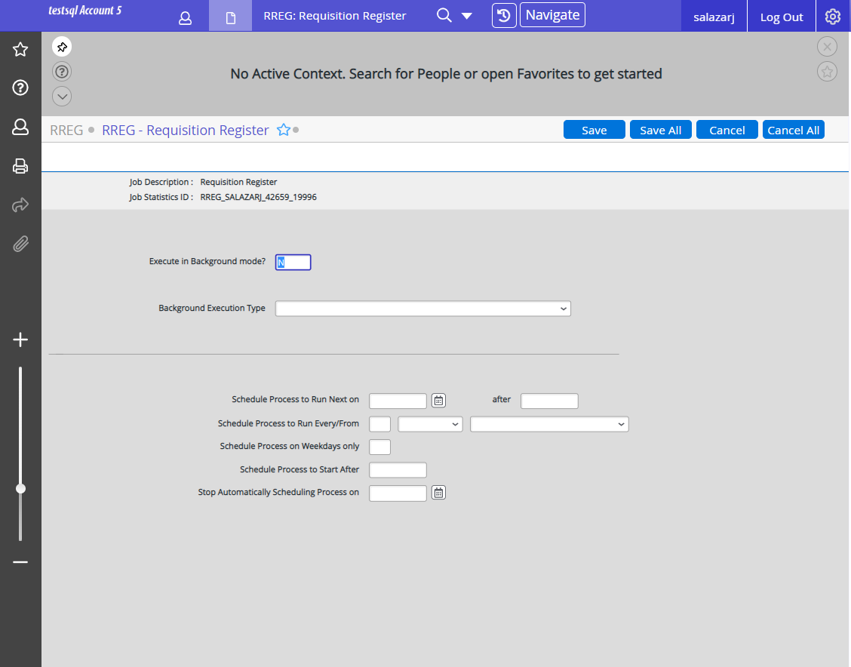
Accessing Requisition Screens
F9 then U(update)

Slide 23
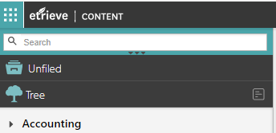
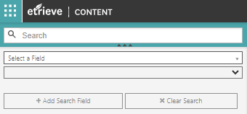
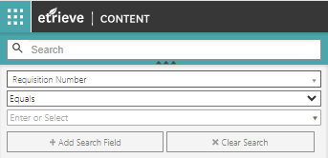
Searching for your Requisition
Go to Etrieve to locate the requisition that you sent through to the ISAIGPTR1 printer
And attach the Back-up to your requisition!
Since you printed the requisition to the ISAIGPTR1 printer the requisition has now been added to Content in Etrieve.
Once you are logged in to Etrieve Content you will then search for your Requisition
To do so, first click on the 3 Triangles
Then click on the drop down for Select a Field
Start typing in Requisition and then choose Requisition Number
Leave the second section as Equals
Paste or Type in the Requisition Number
Make sure to include the leading 0’s

Slide 24
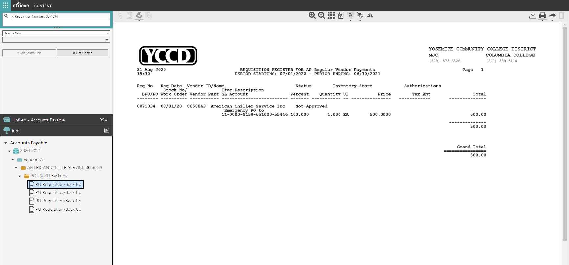
Searching for your Requisition
Once you have entered the Requisition number you will be able to select the Requisition
Verification that the requisition is now in Etrieve Content

Slide 25
Attaching Back-up To Follow (BTF)
If you have access to a scanner and want to scan your document, you can select the scanner icon
To attach the Back-up you would then select the paper with paper clip icon on the tool bar in Etrieve.
The document must be saved as a PDF file for it to attach

Slide 26
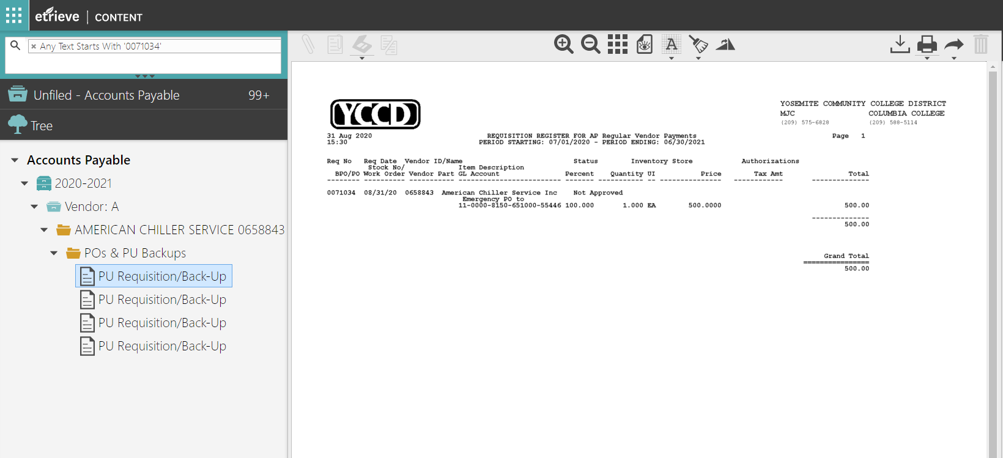
Searching for your Requisition
Once you select your file, click open then your BTF will automatically attach behind your Requisition
You do not need to save your work it's automatically saved

Slide 27
Icon Tool Bar
Delete Pgs.
Make
Notes
Attach BTF
Zoom in & Out
Share
Highlighter
Download
Hide
Delete
Rotate Pg.
Print

Slide 28
Blanket Purchase Orders
A Blanket Purchase Order is one that you set up for a specific amount and then use it to purchase items throughout the whole fiscal year
It is kind of like a line of credit for the amount of the Purchase Order
Sales tax DOES NOT need to be included with Blanket Purchase Orders
Examples of Blanket Purchase Order Transactions:
Advertising Maintenance/Service Contracts
Architect/Engineering Services Membership Fees/Dues
Bus/Vehicle Rental Office Depot
Equipment Rental Pagers/Cell Phone Services
Facility Rental Royalty Fees
Fee Renewals Software Support
Honorariums Subscriptions over $5,000
Leases (Office Equipment) Utilities Services (electric, phone, water)
Legal Services Reoccurring Supplies

Slide 29
Blanket Purchase Orders
The REQM – Requisition Maintenance Screen is also used to create a Blanket Purchase Order
When creating a Requisition for a Blanket Purchase Order make sure the description includes:
Blanket Purchase Order not to Exceed
Authorized Users – list the authorized users
Example: Authorized Users: Bill Gates
Bob Marley
Ann Boleyn
Additional Information is needed in the Comments field (NOT the Printed Comments Field)
If there is a prior year Blanket Purchase Order number
Include Prior Year BPO number in the Comments Field
If there isn’t a prior year Blanket Purchase Order number
Include New Blanket Purchase Order In the Comments Field

Slide 30
Requisition: Tracking
Tracking a requisition once it has been entered
RINQ – Requisition Inquiry
This screen displays the basic information from
REQM – Requisition Maintenance
Combined with information from
RQIL – Requisition Item List

Slide 31
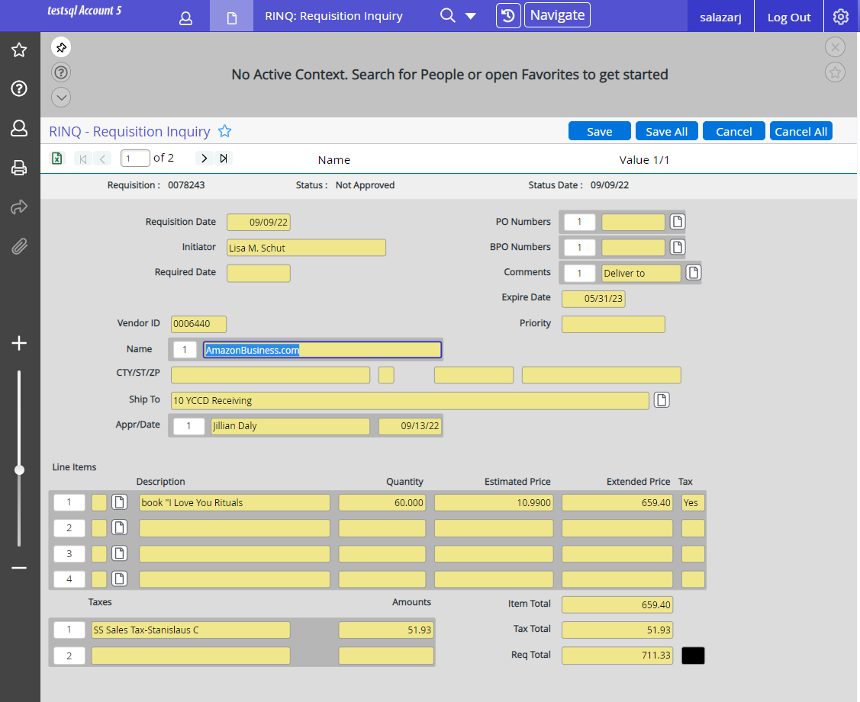
RINQ – Requisition Inquiry
Status
If the Status of the Requisition is “PO Created” you will see
Date the Requisition was created
Purchase Order Number(s) associated with the Requisition
Who Initiated the Requisition
Date the items are required by
Drill down to see PO details on the PINQ Purchase Order Inquiry Screen
Vendor Information
You can also see any comments associated with the requisition
Who has approved the Requisition
You can Drill Down on the Comments to see the full comments
When it was approved
A description of what is being purchased with the requisition
And the total cost associated with the requisition

Slide 32
Requisition: Tracking
PINQ – Purchase Order Inquiry
BINQ – Blanket PO Inquiry
VOUI – Voucher Inquiry
All three screens can be accessed
Directly
Or from the RINQ screen
Use these screens to view information on purchase orders that are currently in the system

Slide 33
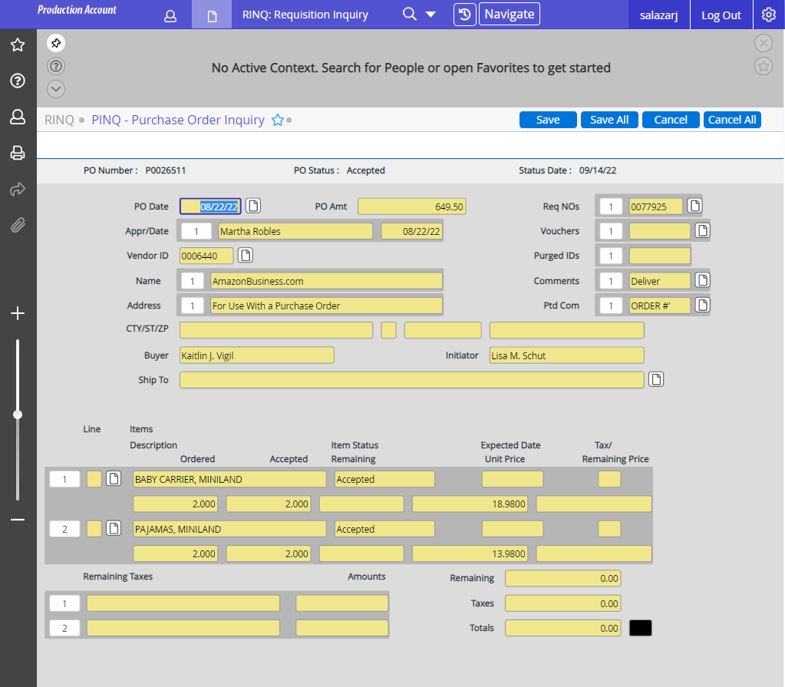
PINQ – Purchase Order Inquiry
The Status of the Purchase Order
Requisition Associated with the Purchase Order
The amount of the Purchase Order
Vouchers Associated with the Purchase Order
Drilling in on the Vouchers will take you to the VOUI – Voucher Inquiry screen

Slide 34
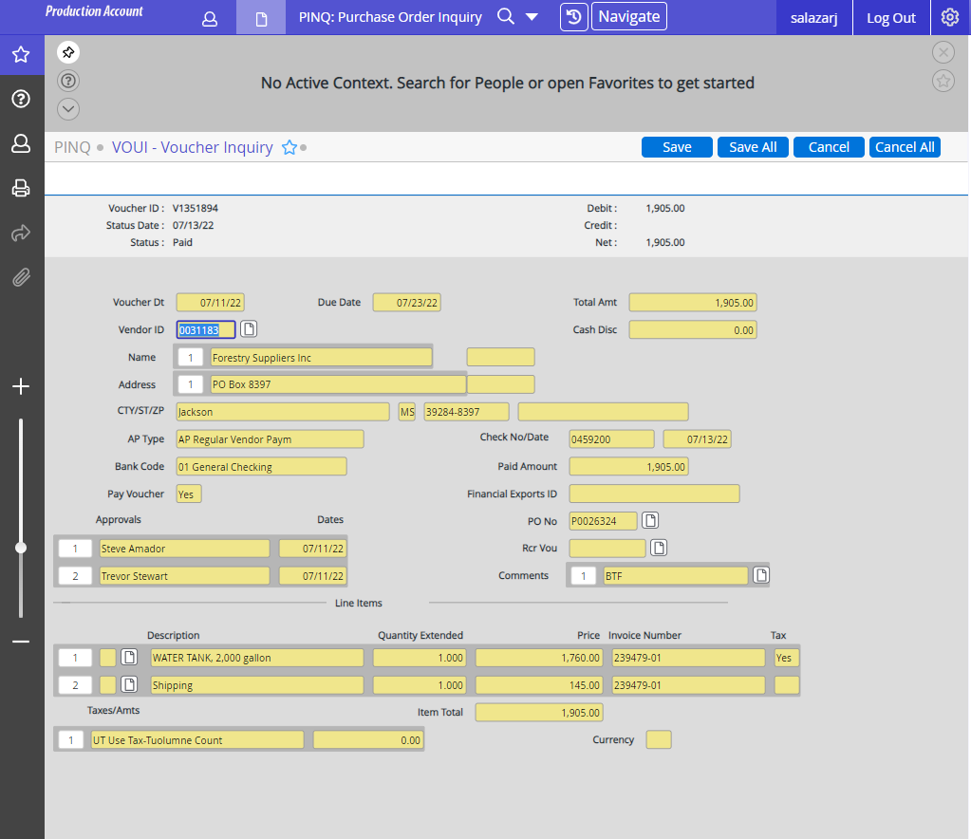
VOUI – Voucher Inquiry
Check number that was used for the payment
The date of the check
And the amount of the check

Slide 35
Purchasing Staff
Dorothy Pimentel
Director of Risk Management, Purchasing & Receiving
209-575-6963
Kaitlin Jimenez
Purchasing Operations Coordinator
209 575-6522
Tarrah Thompson
Administrative Specialist
209 575-6523
Ashley Bird
Administrative Specialist
209 575-6521

