Slide 1


Yosemite Community College District
Retiree Open Enrollment 2019-20
August 5, 2019

Slide 2
Agenda
Welcome
Open Enrollment Information
Health Benefits Information

Slide 3
Open Enrollment
RETIREES- Annual Open Enrollment Period
August 5, 2019 through August 26, 2019
What is Open Enrollment?
Once a year, the District’s medical and dental plans provide for an annual “Open Enrollment Period” during which any eligible employee may change their medical or dental plan and add or terminate any eligible dependents.
Should I participate?
Yes, if:
You want/need to change your health plan (scroll down for required forms)
You need to add dependents that were not added to your benefits within the 31 day time period allowed following a birth/adoption/marriage
You need to drop dependents that are no longer eligible (supporting documentation may be required)
No Action is required if you are not making any plan changes.

Slide 4
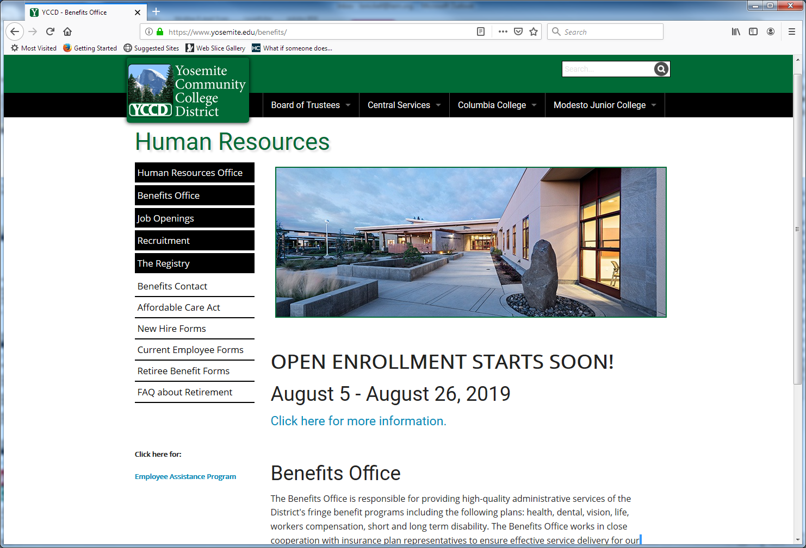
Visit YCCD Benefits site for Benefit and Rate Information

Slide 5
2019-20 Health Benefits Information
Retiree renewal rates increases:
  Retirees under age 65:
    Blue Shield PPO: Increase 7.9% to 8.8%
    Kaiser: Increase 7.7%
  Retirees age 65+
    Kaiser Permanente Senior Advantage (KPSA):
      Decrease from $374 /person/month to $348 /person/month
    CompanionCare (Medicare Supplement with Part D):
      No increase
    Blue Shield PPO:
      No increase

Slide 6
2019-20 PLAN OPTIONS Retirees UNDER age 65 (Continues next page)
Kaiser HMO (Under Age 65) $30 Office Visit Copay No Deductibles or Co-Insurance payments Medical out of pocket maximum: $1,500-individual/$3,000-family
Blue Shield PPO Plan 80-G $30 Office Visit Copay; 20% Treatment Co-Insurance after deductible ($500-individual /$1,000-family) Medical out of pocket maximum: $2,000 individual/$4,000 family includes deductible, co-pays and co-insurance
Detailed plan summaries and SBCs can be found at: https://www.yosemite.edu/benefits/2018openenrollment

Slide 7
2019-20 PLAN OPTIONS Retirees UNDER age 65 (Continued from previous page)
Blue Shield PPO Plan 80-C $20 Office Visit Copay; 20% Treatment Co-Insurance after deductible ($200 individual/$500 family) Medical Out of pocket maximum: $1,000 -individual/$3,000- family; includes deductible, co-pays and co-insurance Blue Shield PPO Plan 90-G $20 Office Visit Copay; 10% Treatment Co-Insurance after deductible ($500 individual/$1,000 family) Medical Out of pocket maximum: $1,000-individual/$3,000- family; includes deductible, co-pays and co-insurance
Blue Shield PPO Plan 100-D $30 Office Visit Copay; No Co-Insurance after deductible ($300-individual/$600-family) Medical out of pocket maximum: $1,000-individual/$3,000-family; includes deductible and office visit copays
Detailed plan summaries and SBCs can be found at: https://www.yosemite.edu/benefits/2018openenrollment

Slide 8
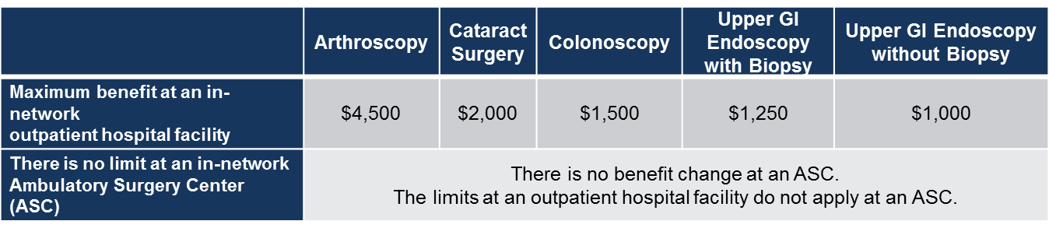
Reminder of October 1, 2018 Benefit Change
Value Based Purchasing– Blue Shield PPO
In order to keep the cost of health benefits affordable and enhance the value of care, the following benefit change was implemented effective October 1, 2018. Reference pricing is now established for five common procedures that can be performed safely at an Ambulatory Surgery Center (ASC) at costs significantly lower than at a hospital.
Blue Shield PPO Members only

Slide 9
Benefit Change Reminder (October 1, 2018): Value Based Purchasing– Blue Shield PPO
Here’s how it works:
In-network ASC – pay regular deductible and co-insurance – no benefit change!
In-network Hospital outpatient facility - pay regular deductible and co-insurance PLUS amounts that exceed the reference price
Benefits of an ASC:
ASCs use the same equipment, medications and supplies as hospital surgical suites
The average facility fees at ASCs are substantially lower than at hospitals
ASCs tend to be more specialized and with less exposure to a wide range of infections
ASCs tend to be high-volume facilities. High-volume facilities are typically associated with having good outcomes
ASCs have established track records of providing quality outcomes that are at least as good as or better than hospitals

Slide 10
Benefit Change Reminder (October 1, 2018): Value Based Purchasing– Blue Shield PPO
Provisions for exceptions:
If the physician provides clinical justification for using a hospital
If member lives more than 30 miles from an ASC
If a procedure cannot be scheduled in a medically appropriate timely manner due to available ASCs not having capacity
Emergencies
Communications regarding this benefit have been sent directly to members; Members with questions should contact the customer service number on their ID card

Slide 11
Benefit Change Reminder (October 1, 2018): Value Based Purchasing– Blue Shield PPO
A list of ASC’s in your area can be found at: https://blueshieldca21-prod.modolabs.net/
Select Find a Doctor
Scroll down to PPO Plan and select “Find providers within California”
Select Facilities
Enter your Location
Select Ambulatory Surgery Center from the drop down
Click Search
  default is 5 mile radius, but can be expanded for additional results

Slide 12
Reminder of October 1, 2018 Pharmacy Benefit Change for Retired Members with Medicare - Blue Shield PPO
Retired PPO Medicare plan members, pharmacy benefit change effective October 1, 2018:
All retired PPO members age 65+ are automatically enrolled in Medicare Part D prescription drug coverage. None of the SISC plans are subject to the Part D “doughnut hole/coverage gap”
Most generic drugs are $0 co-pay at all participating pharmacies
Walgreens included in network for retired PPO members with Medicare (Walgreens is excluded for non-Medicare members)
90 day supply available at all participating pharmacies (excluding specialty)
Costco is the mail-order pharmacy
Reminder: Additional income-base premiums charged by the Federal Government must be paid in order to maintain enrollment in your SISC retiree medical plan. Do not ignore a premium notice.
CMS does not allow a member to be “dual covered” under a Medicare Part D plan.

Slide 13
SISC Blue Shield PPO Plans
 | Network | Non-network
Choosing a doctor | Visit any PPO network physician. | Visit any non-network physician, pay for the services, and submit claims to Blue Shield. Not all non-network services are covered.
Access to specialists | Visit any PPO network specialist; no referral is required. | Visit any non-network specialist and submit claims to Blue Shield. No referral is required.
Out-of-pocket costs | After the plan-year deductible is met, pay a percentage of costs for covered in-network services up to plan stated out-of- pocket maximum. | After the plan-year deductible is met, pay a percentage of costs and all costs above the allowable amount.
Blue Shield PPO Plan Pharmacy benefits are provided by Navitus Health Solutions:
800-607-6861 / www.navitus.com
Plan features $0 co-pay on most generic drugs at Costco (all PPO members)
Walgreens is excluded (active employees and retirees under age 65
Up to 90 days supply available through Costco retail or mail-order
Costco Mail-order: pharmacy.costco.com
  Retired PPO members age 65+ can access $0 generic co-pays for up to 90-day supply at any network pharmacy

Slide 14

Find a network provider
It’s easy to find a PPO provider online 1. Go to blueshieldca.com/sisc 2. Select Find a Provider 3. Under “Find a PPO Network Provider,” choose the provider you are looking for | How to find a PPO network mental health/ substance abuse provider Follow the first three steps for finding a PPO network doctor, and: 1. Select Doctors, then under “Doctor Type or Specialty,” choose Mental Health Caregivers 2. On the screen that appears, select your plan and click Next 3. On the next screen that appears, click on Search Blue Shield of California Network 4. Enter your City, State or Zip and click Find Now.
Finding providers outside of California
The BlueCard Program gives SISC PPO participants access to care across the United You can locate a BlueCard provider at any time by calling (800) 810-BLUE (2583).
If you don’t have access to the Internet or need help, simply contact your dedicated Blue Shield Member Services team at (855) 599-2657 for personal assistance or to request a provider directory.

Slide 15
Coverage for urgent/emergent services outside the U.S. - Blue Shield PPO
If you require inpatient care, call the BlueCard Worldwide Service Center collect at (804) 673-1177 from outside the country or (800) 810-BLUE (2583) from within the United States.
In most cases, you won’t need to pay up front for inpatient care at BlueCard Worldwide hospitals, except the out-of-pocket expenses you’d normally pay.
You should also contact the customer service number on your Blue Shield ID card to get medical authorization. The hospital should submit the claim on your behalf if it is a BlueCard provider.
In the event that there are no BlueCard providers in the country you’re visiting, go to any provider, pay them directly for your healthcare services, and then submit the itemized bill to Blue Shield for reimbursement.
If you’re taking medication and plan to work or travel abroad, we suggest you obtain a sufficient supply of your regular prescription drugs to last the duration of your stay. If you need to get medication as a result of emergency treatment while traveling abroad, you will need to pay for it at that time and then submit the bill along with your completed international claim form for reimbursement

Slide 16

2019-20 PLAN OPTIONS Retirees age 65+
Kaiser Permanente Senior Advantage HMO (Age 65+)
$10 Office Visit Copay
No Deductibles or Co-Insurance payments
Medical out of pocket maximum: $1,500-individual/$3,000-family
Reminder, Hearing Aid Benefits were added to Kaiser plans effective October 1, 2018:
A hearing aid benefit is now available on all traditional Kaiser HMO, and Senior Advantage plans.

Slide 17

Kaiser Permanente Senior Advantage
Benefit overview - Retirees Age 65 with Medicare Assigned to KP
  $10 office visit copay
  Medicare Part D drug coverage:(up to a 100 day supply): $10 generic / $20 brand (No doughnut hole / coverage gap)
  No deductible
  $50 ER copay (waived if admitted directly to hospital)
  Hospitalization: No Charge
  Maximum annual copayment liability is $1,500 individual / $3,000 family
  Vision benefit allowance at Kaiser Optical: $150 toward eyeglasses or contact lenses every 24 months.
  Chiropractic and acupuncture benefit $10 / 30 visits per year
  (must be authorized by ASH)
  Silver & Fit Exercise and Healthy Aging Program

Slide 18
Kaiser Permanente Senior Advantage
New Feature: Silver & Fit Exercise and Healthy Aging Program
  Available only to KPSA members
  Benefits include:
    Gym Membership at participating clubs
    Home Fitness Program
    Healthy Aging Resource Library
To learn more about Silver&Fit, including how to register and find fitness facilities near you, visit SilverandFit.com.
Local participating gyms include:
Brenda, Fit Republic, Curves, The House Fitness, In-Shape

Slide 19
Kaiser Permanente Senior Advantage
Important Kaiser Reminders:
You must physically live in the Kaiser Permanente Senior Advantage service areas to enroll in Kaiser
You must enroll in Medicare Parts A & B, and assign Medicare to Kaiser
Member responsible for cost of services not authorized by Kaiser Permanente
Emergency services available when traveling outside the Kaiser Service area
In non-emergency, always begin by calling Kaiser Customer Service for guidance in accessing care

Slide 20

My Health Manager on kp.org
Email your doctor’s office - send secure, routine messages to your physician’s office and get a response, usually within two business days.
Refill prescriptions - order your prescription refills and have most of them mailed to your home—and postage is free.
Request, cancel, or review routine appointments
and check past office visit information.
View recent immunizations, most lab test results, allergies, and your eligibility and benefits information.
Act for a family member. Access most of your family members’ health information using our secure online features.
    Help take care of a family member, like a child or parent, using these features and more

Slide 21
Expert Medical Opinion Service - Available to SISC PPO and Kaiser members under age 65 (Early Retirees)
Results:
Improved Diagnosis: 39%
Modified Treatment: 60%
This benefit gives members the opportunity to have their case reviewed by physicians at top institutions.
No travel required
The service gathers all of the members medical records
Turnaround is typically 2-3 weeks
Service is voluntary and provided at no charge
Member feedback:
“A doctor actually called me on the phone. My previous doctor who I had for years never only communicated with me personally. He also diagnosed my problem immediately. I have had problems with my stomach undiagnosed for years.”
“It blew my mind how much information and care went into the expert opinion. I never knew what was going on with my health all of these years. I will tell my colleagues about this.”
“…. we want to thank you for all of your help. I believe we received a well-rounded second opinion and are better informed about our options.”
  Get started by calling 855-201-9925 or advance-medical.net/sisc
It’s free and confidential
Available to SISC PPO and Kaiser members under age 65 (Early Retirees).
Not available to Retirees with Medicare

Slide 22
Blue Shield PPO Added Features
To learn more, activate
you account online,
please visit
mdlive.com/sisc or call
(888) 632-2738
Available to SISC PPO members under age 65 (Early Retirees)

Slide 23
Additional Plan Option: Retirees 65+
CompanionCare Medicare Supplement Plan with Medicare Part D prescription drug coverage
Enrollment in Medicare Part A & B required
Member retains original Medicare A & B
Member may access medical services with any U.S. provider who accepts Medicare assignment
Member self-refers to any U.S. provider who accepts Medicare assignment
When the medical service is approved by Medicare, and the provider accepts Medicare assignment, the member cost share is zero.
Member co-pays for prescriptions: $9 generic, $35 brand. Costco zero copay program does NOT apply.
SISC’s CompanionCare Plan is a Medicare Supplement Plan administered by Anthem Blue Cross. The CompanionCare Plan includes automatic enrollment Medicare Part D Prescription Drug Plan, administered by Navitus Health Solutions. – NO “Doughnut Hole” or Coverage Gap
SISC allows mid-year change to CompanionCare; a change back to the PPO would only be permitted during open enrollment. Contact your benefits department at least 60 days prior to desired plan effective date. SISC requires at least 45 days for enrollment processing.
2019-20 Monthly Single Rate: $386 (This premium is over $100 per person less than the PPO)

Slide 24

Customer Service Contact Information
Kaiser Permanente www.kaiserpermanente.org 800-464-4000
Blue Shield blueshieldca.com 800-642-6155
Navitus-Prescription Benefit for Blue Shield PPO: www.navitus.com 866-333-2757
Delta Dental www.deltadentalins.com 866-499-3001
Vision Service Plan (VSP) www.vsp.com 800-877-7195
EAP www.anthemeap.com 800-999-7222 Program name: SISC
Advance Medical www.advance-medical/sisc 855-201-9925
MDLive (Blue Shield PPO members) www.mdlive.com/sisc 888-632-2738
Members have access to dedicated customer service specialists. These specialists provide an excellent resource for member questions on a variety of topics such as ID card requests, benefit details, claims, providers, and appeals. Member must be in carrier’s system in order for customer service to provide assistance.

Slide 25
Definitions
Copay: A fixed amount (for example $30) you pay for a covered health care service, usually when you obtain the service. This amount can vary by the type of covered health care service.
Deductible: The amount you owe for covered health care services before your plan begins to pay.
Out of Pocket Maximum (OOPM): The most you pay during a policy period (January – December) before your health insurance or plan start to pay 100% for covered services. The limit includes deductibles, coinsurance, and copayments for covered services with contracted providers
The Blue Shield PPO plans have separate OOPM for Medical and Pharmacy.

Slide 26
Other Benefits
Dental and Vision
  Rates are not increasing
  Retirees must enroll upon first date of eligibility
Questions?
Thank you for your attendance

